Slide 1
Hiring Process Analytics

Slide 2
Approach
Project Description
The hiring process is a crucial function of any company, and understanding trends such as the number of rejections, interviews, job types, and vacancies can provide valuable insights for the hiring department.
The approach towards this project is to analyze the data thoroughly and to understand business problem.
Tech-Stack Used
This project is done in MS EXCEL to explore, analyze and visualize data. And the report is submitted in Power Point Presentation

Slide 3
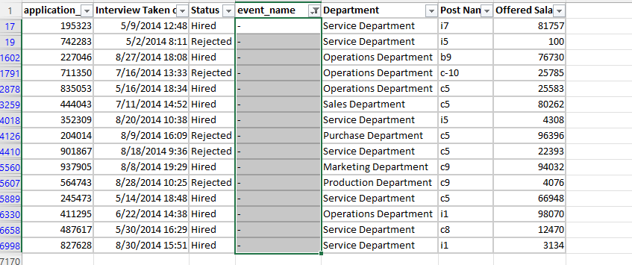
Handling Missing Data
In the data only event_name (15), offered salary(1) have the missing data or blanks.
It better to drop the missing column here

Slide 4
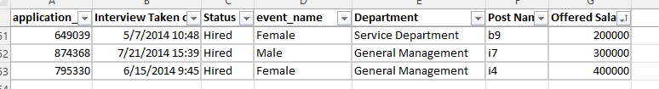
Outlier Detection
Check for outliers in the dataset that may skew your analysis.
Decide on the best strategy to handle outliers. This could be removing them, replacing them, or leaving them as is, depending on the situation.
Found 3 outliers which was deleted while working on salary distribution

Slide 5
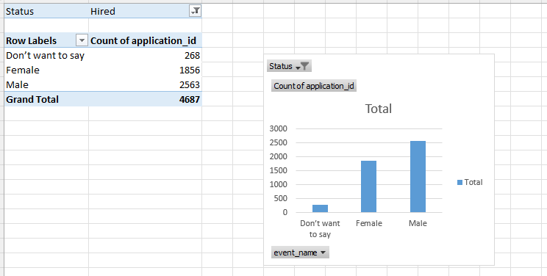
A. Hiring Analysis
The hiring process involves bringing new individuals into the organization for various roles based on gender.

Slide 6
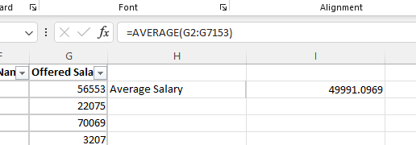
B. Salary Analysis
The average salary is calculated by adding up the salaries of a group of employees and then dividing the total by the number of employees.

Slide 7
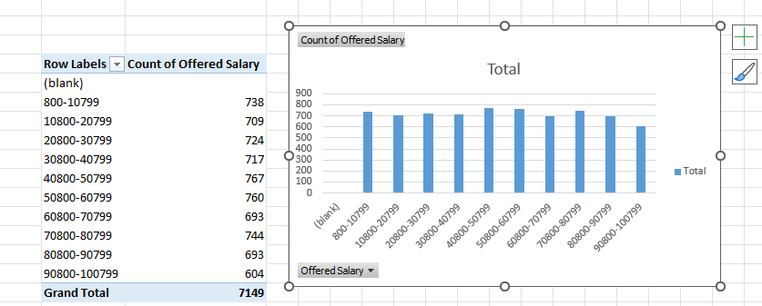
C. Salary Distribution
Class intervals represent ranges of values, in this case, salary ranges. The class interval is the difference between the upper and lower limits of a class.

Slide 8
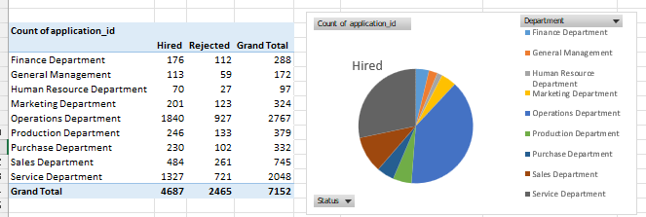
D. Departmental Analysis
Visualizing data through charts and plots is a crucial part of data analysis.

Slide 9
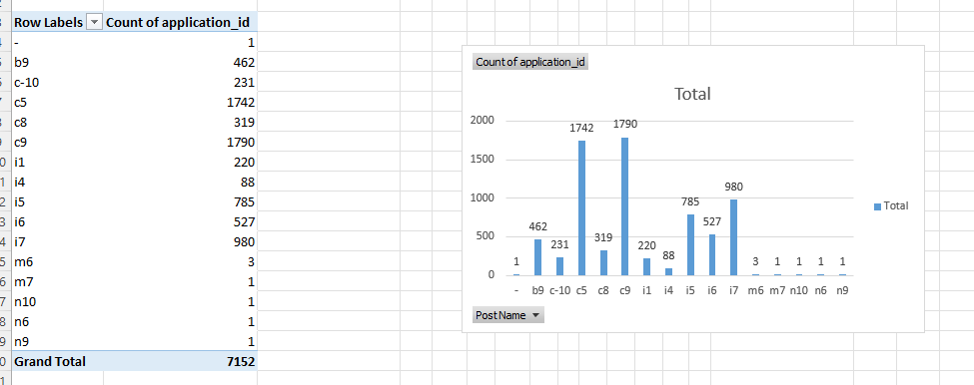
E. Position Tier Analysis
Different positions within a company often have different tiers or levels.

Slide 10
Insights
From these project I get to know the following:
Total 4687 applicants are hired, among them 1856 are female, 2563 are male and rest don’t want to say
The average salary is 49991.097
Distribution of salary
Out of 4687 hired applicants, operational department have the highest of 1840 operation department and lowest of 70 HR department
Number of people in different posts

Slide 11
THANK YOU

